Slide 1
Apriori Algorithm
Group 9:
Trương Đăng Quang - 1952940
Nguyễn Quốc Quy - 1852704
Nguyễn Đình Sáng - 1952955
Nguyễn Minh Tâm - 1952968

Slide 2
Table of contents
Market Basket Analysis
Association Rule Mining
Apriori Algorithm
Improve the efficiency of
Apriori Algorithm
5. Python demo

Slide 3
1.
Market Basket Analysis

Slide 4

Market Basket Analysis
Market Basket Analysis
One of the key techniques used by retailers to uncover associations between items.
Look for combinations of items occurring together frequently.

Slide 5
Market Basket Analysis
Which items are frequently purchased together by the customers?

Slide 6

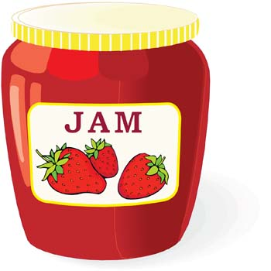


Market Basket Analysis
Market Basket Analysis
Bread and Jam
Laptop and Bag
Notes:
For example:
People who purchase bread have a likelihood to purchase Jam
Customers who purchase laptops are more likely to purchase a Laptop Bag
Try to find out associations between different items and products that can be sold together.
So the organizations can place products in a similar manner

Slide 7


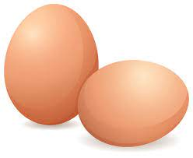
Market Basket Analysis
Market Basket Analysis
Bread, Butter and Eggs
Notes:
For example:
people who buy bread also buy butter. So the marketing team target customers who buy bread and butter
And provide them so that they buy a third item,
Suppose eggs, so if a customers buy bread and butter and see a discount on eggs.
They will be encouraged to buy eggs.

Slide 8
2.
Association Rule Mining
Notes:
Thanks Quang,
Our next part is Association Rule Mining,
As you have just heard the example from Quang about market backet analysis an example of applying Association Rule Mining, finding the combinations of items in the supermarket will help us maximize profits.

Slide 9
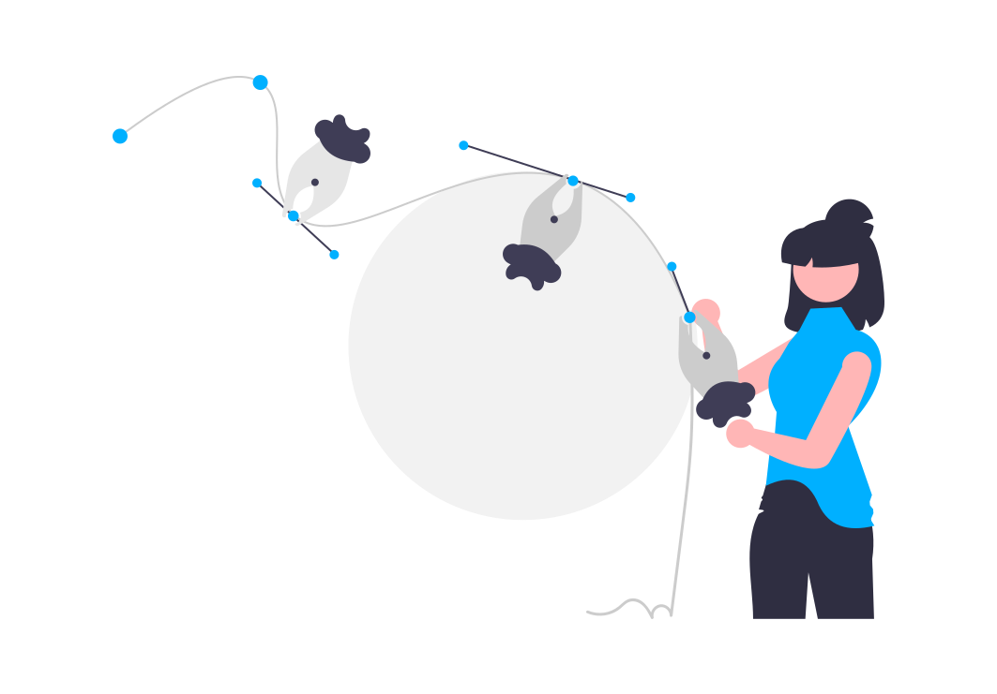
A → B
Association rule mining
If Then
Notes:
And to find reliable combinations to apply to business, through the use of Association Rule Mining we will evaluate the best relationships. By definition, Association Rule Mining is a data mining process, a learning technique of finding the rules that may govern associations and relationship between sets of items.
Suppose that we a relationship A arrow B, that means if a customer buy item A, he also buy item B, and we need to evaluate
this relationship is reliable or not. How we can do that?

Slide 10
A → B
Association rule mining
If Then
Support
Measure
Association
Confidence
Lift
Notes:
In association rule mining, to determine a good combination, we rely on 3 factors: support, confidence and lift, and what are they

Slide 11
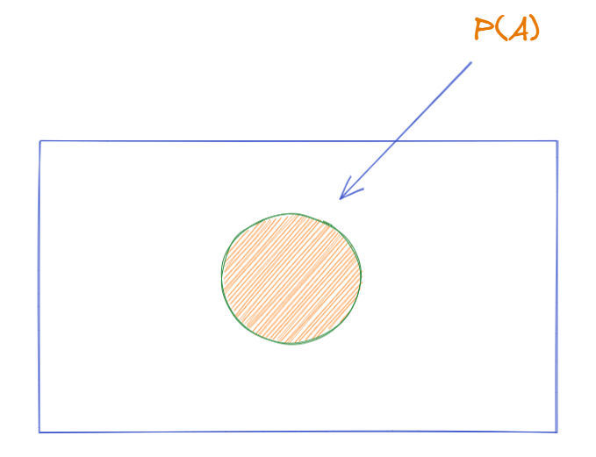
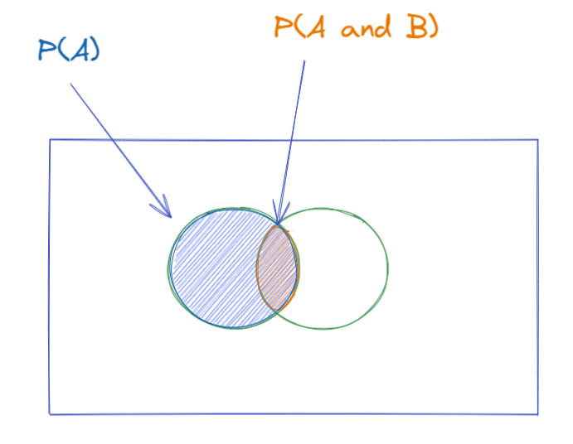
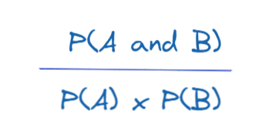
Association rule mining
Support - The area of the orange circle
Confidence - The ratio of orange (overlap) area with respect to blue area
Lift - The ratio of probabilities
Source: The Data School
Notes:
Take a look at the pictures on the slide
Support:
Within a dataset, i.e. a list of transactions, how many transactions contain item A, so it is just the probability of item A occurring, which we can represent as below. Statistically speaking, it is a frequentist estimate of the probability.
Confidence:
Out of the transactions that contains item A, how many also contains item B. The bigger the overlap, the greater the confidence we have that people who are buying item A also buys item B. Statistically speaking, it is (estimated) conditional probably of item B given item A, i.e. P(B|A).
Lift:
The ratio between Confidence of A and Support B, it is less intuitive with the description, so let's try to visualize it better. First let's see the formula below.

Slide 12
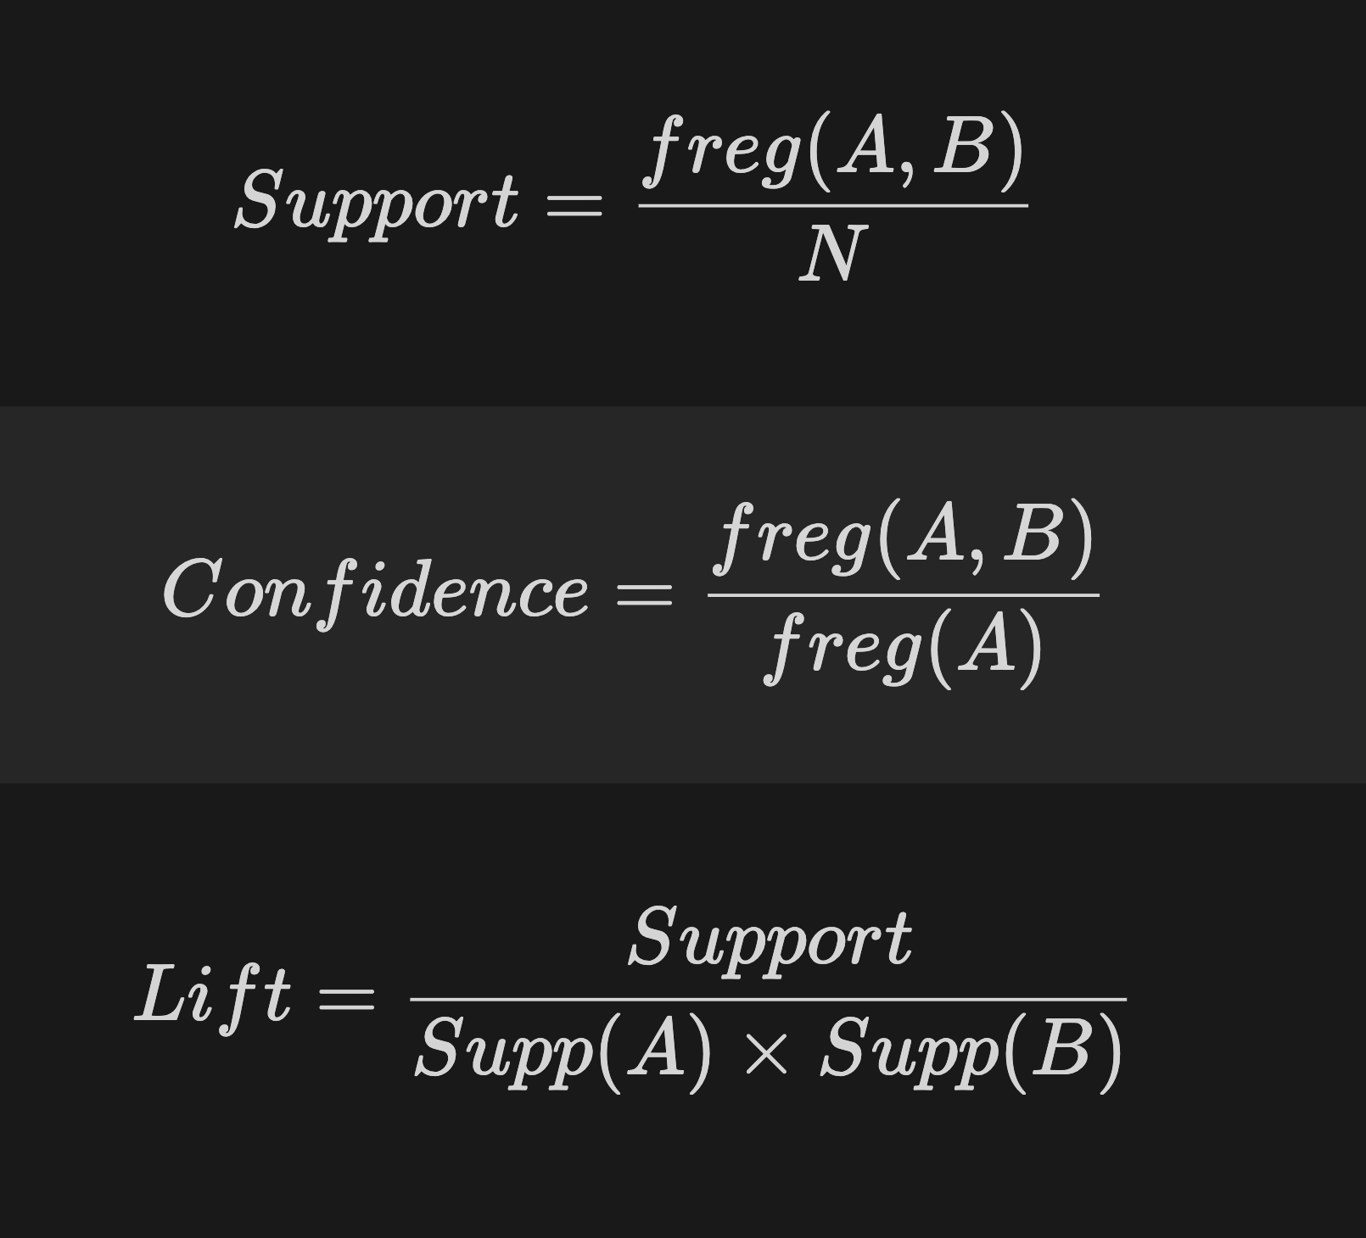
A → B
Association rule mining
If Then

Slide 13

Association rule mining
A
A
B
T1 | A, B, C
T2 | A, C, D
T3 | B, C, D
T4 | A, D, E
T5 | B, C, E
B
C
C
C
D
D
A
B
D
C
E
E

Slide 14

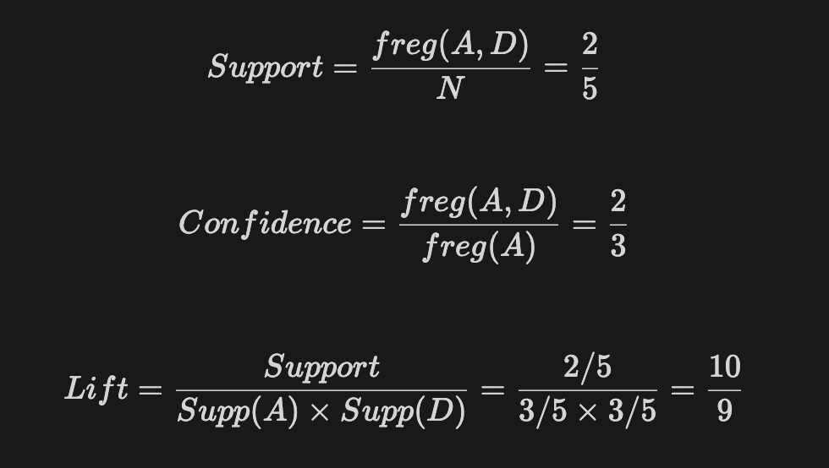
Association rule mining
Rules: A → D C → A A → C B, C → A
T1 | A, B, C
T2 | A, C, D
T3 | B, C, D
T4 | A, D, E
T5 | B, C, E
Rule | Support | Confidence | Lift
A → D | 2/5 | 2/3 | 10/9

Slide 15
Association rule mining
Rules: A → D C → A A → C B, C → A
Rule | Support | Confidence | Lift
A → D | 2/5 | 2/3 | 10/9
C → A | 2/5 | 2/4 | 5/6
A → C | 2/5 | 2/3 | 5/6
B, C → A | 1/5 | 1/3 | 5/9

Slide 16
3.
Apriori Algorithm

Slide 17

Apriori Algorithm
Apriori Algorithm
Proposed by R. Agrawal & R. Srikanth in 1994.
Name of the algorithm is based on the fact that it uses prior knowledge of the frequent itemset properties.
Employ iterative approach known as level-wise search where k-itemsets are used to explore (k+1)-itemsets.

Slide 18
Apriori Method
Apriori Algorithm
Method:
Initially, scan DB once to get frequent 1-itemset.
Generate length (k+1) candidate itemsets from length k frequent itemsets.
Terminate when no frequent or candidate set can be generated.
To improve the efficiency, use Apriori property to reduce the search space
All non-empty subsets of a frequent itemset must also be frequent

Slide 19
Apriori Algorithm - Example
Apriori Algorithm
min_sup = 2
C1
L1
D
Itemset | Sup
{A} | 2
{B} | 3
{C} | 3
{D} | 1
{E} | 3
Tid | Items
10 | A, C, D
20 | B, C, E
30 | A, B, C, E
40 | B, E
Itemset | Sup
{A} | 2
{B} | 3
{C} | 3
{E} | 3
1st scan
{D} | 1
Itemset with support value < min_sup is eliminated

Slide 20
Apriori Algorithm - Example
Apriori Algorithm
C2
C2
Itemset
{A, B}
{A, C}
{A. E}
{B, C}
{B, E}
{C, E}
Itemset | Sup
{A, B} | 1
{A, C} | 2
{A. E} | 1
{B, C} | 2
{B, E} | 3
{C, E} | 2
L2
{A, B} | 1
Itemset | Sup
{A, C} | 2
{B, C} | 2
{B, E} | 3
{C, E} | 2
2nd scan
{A, E} | 1

Slide 21
Apriori Algorithm - Example
Apriori Algorithm
C3
L3
3rd scan
Itemset | Sup
{B, C, E} | 2
Itemset
{B, C, E}

Slide 22
Generating Association Rules from Frequent Itemsets
Apriori Algorithm
Method:
For each frequent itemset l, generate all nonempty subsets of l.
For every nonempty subset s of l, output the rule “s (l - s)” if
support_count(l)
support_count(s)
≥ min_conf

Slide 23
Generating Association Rules - Example
Apriori Algorithm
L3
Itemset | Sup
{B, C, E} | 2
For I = {B, C, E}, subsets are {B}, {C}, {E}, {B, C}, {B, E}, {C, E}
Rule 1: {B} ({B, C, E} - {B}) means B C & E
Confidence(B) = support(B, C, E) / support(B) = 2/3 = 66.67%.
Apply the same techniques to C & E:
Confidence(C) = 2/3 = 66.67% Confidence(E) = 2/3 = 66.67%

Slide 24
Generating Association Rules - Example
Apriori Algorithm
L3
Itemset | Sup
{B, C, E} | 2
For I = {B, C, E}, subsets are {B}, {C}, {E}, {B, C}, {B, E}, {C, E}
Rule 4: {B, C} ({B, C, E} - {B, C}) means B, C E
Confidence(B, C) = support(B, C, E) / support(B, C) = 1 = 100%.
Apply the same techniques to {B, E} & {C, E}:
Confidence(B, E) = 2/3 = 66.67% Confidence(C, E) = 1 = 100%

Slide 25
4.
Improve the efficiency
of Apriori Algorithm

Slide 26
Limitation of Apriori Algorithm
Improve Apriori Algorithm
Mining from a large dataset generates a large number of itemsets or subsets in each iteration.
Scanning the database too much can cause detrimental effect on the overall performance.
For example, a frequent itemset of length 100, such as {a₁, a₂, ..., a₁₀₀} contains 100 frequent 1-itemsets: {a₁}, {a₂}, …, {a₁₀₀}; frequent 2-itemsets: {a₁, a₂}, {a₁, a₃}, …, {a₉₉, a₁₀₀} and so on. The total number of frequent itemsets that it can contain ≃ 2¹⁰⁰ - 1 ≃ 1.27 x 10³⁰

Slide 27
“How can we further improve the efficiency of Apriori-based mining ?”
Improve Apriori Algorithm
The following techniques and methods improves the efficiency of Apriori algorithm:
Hash-based technique
Transaction reduction
Partitioning technique
Sampling technique
Dynamic itemset counting

Slide 28
Hash-based technique
Improve Apriori Algorithm
In hash-based technique, the hash table is used as data structure.
In first iteration, support count is compulsory of each itemset.
In second iteration, hash table minimizes the number of itemsets generated.
Generate all the 2-itemsets and map them into the different buckets of hash table and increase the corresponding bucket counts.
The bucket count in the hash table is less than minimum support threshold cannot be frequent and thus should be removed from the candidate set.

Slide 29
Hash-based technique
Improve Apriori Algorithm
Database transaction table
Transaction id’s | List of item id’s
T100 | I1, I2, I5
T200 | I2, I4
T300 | I2, I3
T400 | I1, I2, I4
T500 | I1, I3
T600 | I2, I3
T700 | I1, I3
T800 | I1, I2, I3, I5
T900 | I1, I2, I3
1-itemset (C₁)
Itemset | Support count
I1 | 6
I2 | 7
I3 | 6
I4 | 2
I5 | 2

Slide 30
2-itemset (C₂)
Improve Apriori Algorithm
Itemset | Support count
I1, I2 | 4
I1, I3 | 4
I1, I4 | 1
I1, I5 | 2
I2, I3 | 4
I2, I4 | 2
I2, I5 | 2
I3, I4 | 0
I3, I5 | 1
I4, I5 | 0
Itemset | Support count
I1 | 6
I2 | 7
I3 | 6
I4 | 2
I5 | 2

Slide 31
2-itemset (C₂)
Improve Apriori Algorithm
Itemset | Support count
I1, I2 | 4
I1, I3 | 4
I1, I4 | 1
I1, I5 | 2
I2, I3 | 4
I2, I4 | 2
I2, I5 | 2
I3, I4 | 0
I3, I5 | 1
I4, I5 | 0
Transaction id’s | List of item id’s
T100 | I1, I2, I5
T200 | I2, I4
T300 | I2, I3
T400 | I1, I2, I4
T500 | I1, I3
T600 | I2, I3
T700 | I1, I3
T800 | I1, I2, I3, I5
T900 | I1, I2, I3

Slide 32
Itemset | Support count | Hash function h(x, y) = [(order of x) * 10 + (order of y)] % 7
I1, I2 | 4 | (1*10 + 2) % 7 = 5
I1, I3 | 4 | (1*10 + 3) % 7 =6
I1, I4 | 1 | (1*10 + 4) % 7 = 0
I1, I5 | 2 | (1*10 + 5) % 7 = 1
I2, I3 | 4 | (2*10 + 3) % 7 = 2
I2, I4 | 2 | (2*10 + 4) % 7 = 3
I2, I5 | 2 | (2*10 + 5) % 7 = 4
I3, I4 | 0 | null
I3, I5 | 1 | (3*10 + 5) % 7 = 0
I4, I5 | 0 | null
min_sup = 3
Order of items:
I1=1, I2=2, I3=3, I4=4, I5=5

Slide 33
Improve Apriori Algorithm
Hash table, H_{2,} for candidate 2-itemsets. If bucket count < 3, itemsets in buckets 0, 1, 3, 4 cannot be frequent so they should not included in C₂ and for L₂
Bucket address | 0 | 1 | 2 | 3 | 4 | 5 | 6
Bucket count | 2 | 2 | 4 | 2 | 2 | 4 | 4
Bucket contents | {I1, I4} {I3, I5} | {I1,I5} {I1,I5} | {I2,I3} {I2,I3} {I2,I3} {I2,I3} | {I2, I4} {I2, I4} | {I2, I5} {I2, I5} | {I1, I2} {I1, I2} {I1, I2} {I1, I2} | {I1, I3} {I1, I3} {I1, I3} {I1, I3}
➱ Advantage: reduce the number of scans and remove large candidates or itemsets that cause high input/output cost.

Slide 34
Transaction reduction method
Improve Apriori Algorithm
A transaction that does not contain any frequent k-itemsets cannot contain any frequent (k+1)-itemsets.
Such a transaction can be marked or removed from further consideration because subsequent database scans for j-itemsets, where j > k, will not need to consider such a transaction.

Slide 35
min_sup = 2
Tid’s | I1 | I2 | I3 | I4 | I5
T100 | 1 | 1 | 0 | 0 | 1
T200 | 0 | 1 | 1 | 1 | 0
T300 | 0 | 0 | 1 | 1 | 0
T400 | 1 | 1 | 1 | 1 | 0
Tid’s | List of item
T100 | I1, I2, I5
T200 | I2, I3, I4
T300 | I3, I4
T400 | I1, I2, I3, I4
Read support count from database table
Check support of transaction wise or item wise < min_sup
Tid’s | I1 | I2 | I3 | I4
T100 | 1 | 1 | 0 | 0
T200 | 0 | 1 | 1 | 1
T300 | 0 | 0 | 1 | 1
T400 | 1 | 1 | 1 | 1
Tid’s | I1 | I2 | I3 | I4 | I5
T100 | 1 | 1 | 0 | 0 | 1
T200 | 0 | 1 | 1 | 1 | 0
T300 | 0 | 0 | 1 | 1 | 0
T400 | 1 | 1 | 1 | 1 | 0
Remove I5 column

Slide 36
Improve Apriori Algorithm
min_sup = 2
Tid’s | I1 | I2 | I3 | I4
T100 | 1 | 1 | 0 | 0
T200 | 0 | 1 | 1 | 1
T300 | 0 | 0 | 1 | 1
T400 | 1 | 1 | 1 | 1
Tid’s | I1, I2 | I1, I3 | I1, I4 | I2, I3 | I2, I4 | I3, I4
T100 | 1 | 0 | 0 | 0 | 0 | 0
T200 | 0 | 0 | 0 | 1 | 1 | 1
T300 | 0 | 0 | 0 | 0 | 0 | 1
T400 | 1 | 1 | 1 | 1 | 1 | 1
Generated candidates of 2-itemset
Check support of transaction wise, item wise < min_sup & remove them
Check support of item wise < min_sup
& remove them
Tid’s | I2, I3 | I2, I4 | I3, I4
T200 | 1 | 1 | 1
T400 | 1 | 1 | 1
Tid’s | I1, I2 | I1, I3 | I1, I4 | I2, I3 | I2, I4 | I3, I4
T200 | 0 | 0 | 0 | 1 | 1 | 1
T400 | 1 | 1 | 1 | 1 | 1 | 1

Slide 37
Improve Apriori Algorithm
Database Table
This is final frequent 3-itemset
Tid’s | List of item
T100 | I1, I2, I5
T200 | I2, I3, I4
T300 | I3, I4
T400 | I1, I2, I3, I4
Tid’s | I2, I3, I4
T200 | 1
T400 | 1

Slide 38
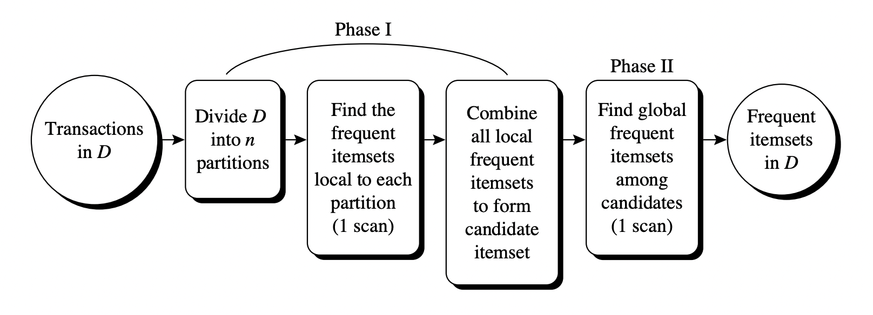
Partitioning technique
Improve Apriori Algorithm
Can be used that requires just 2 database scans to mine frequent itemsets.
Figure: Mining by partitioning the data.

Slide 39
Sampling technique
Improve Apriori Algorithm
The basic idea: pick a random sample S of the given data D, and then search for frequent itemsets in S instead of D.
The S sample size is such that the search for frequent itemsets in S can be done in main memory, and so only one scan the transaction in S is required overall.
Use a lower support threshold than minimum support to find the frequent itemsets local to S (denoted L^{S} ).
If L^{S} actually contains all frequent itemsets in D, then only one scan of D is required.

Slide 40
Dynamic itemset counting
Improve Apriori Algorithm
A dynamic itemset counting technique reduces the number of passes made over the data while keeping the number of itemsets which are counted in any pass relatively low.
This technique can add new candidate itemsets at any marked start point of the database during the scanning of the database.

Slide 41
5.
Python demo

Slide 42
Thank you for listening!

